Slide 1


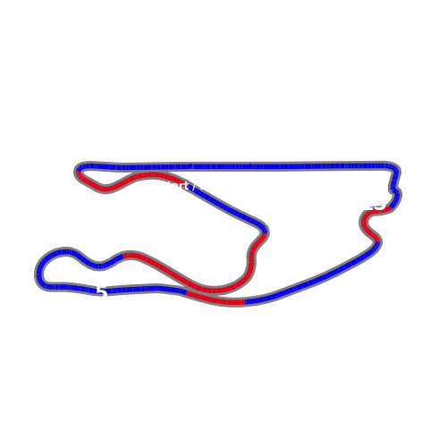


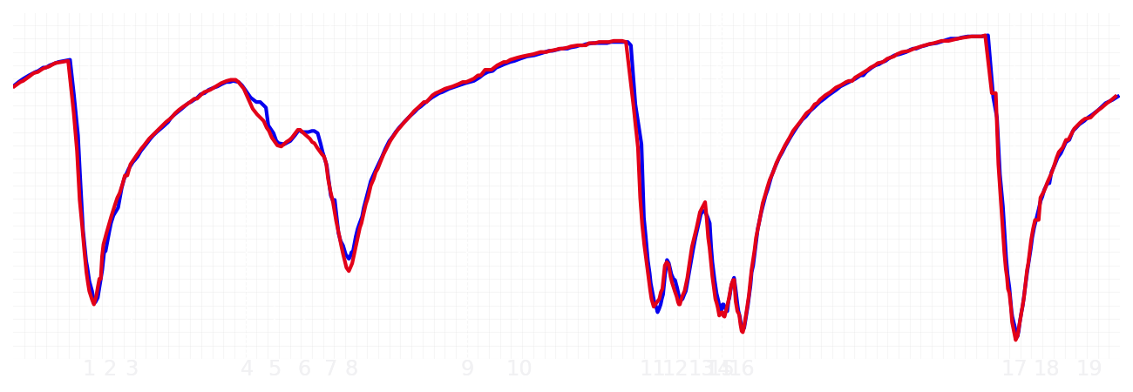
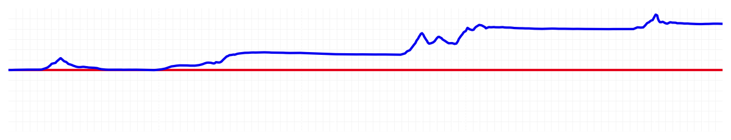
Miami GP Qualifying Q3
Max Verstappen
Driver
Yuki Tsunoda
Driver
Lap Time
01:26.204
01:26.943
Lap Time
Sector 1
28.246
Speed Trap 1
223 kp/h
Speed Trap 1
222 kp/h
Sector 1
28.551
Sector 2
33.079
Speed Trap 2
192 kp/h
Gap
-0.739
Gap
0.739
Speed Trap 2
191 kp/h
Sector 2
33.410
Sector 3
24.879
Speed Final Line
282 kp/h
Corner Advantage
8/20
Corner Advantage
12/20
Speed Final Line
281 kp/h
Sector 3
24.982
FULL THROTTLE
64%
63%
FULL THROTTLE
HEAVY BREAKING
16%
17%
HEAVY BREAKING
%LAP TIME
CORNERING
20%
20%
CORNERING
%LAP TIME
SPEED
SPEED
DELTA TIME
DELTA TIME

Slide 2

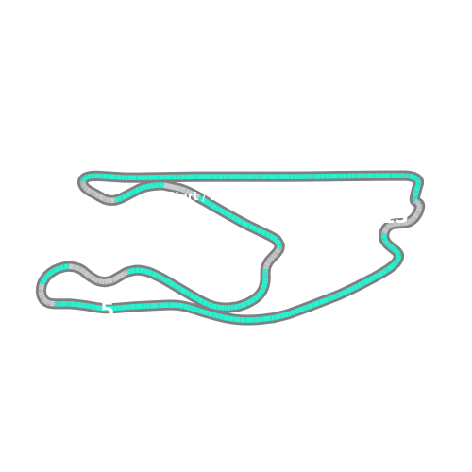


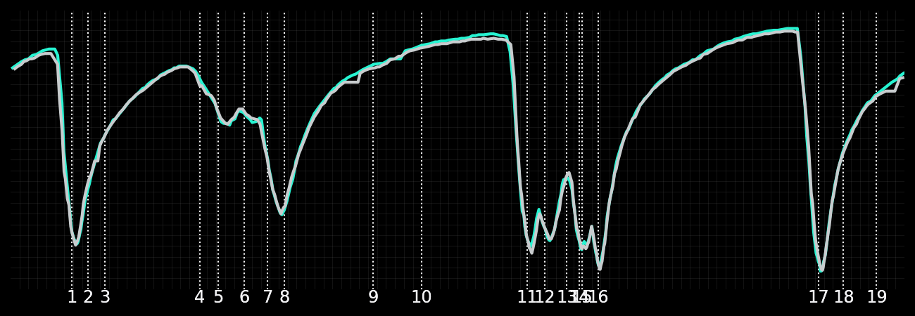
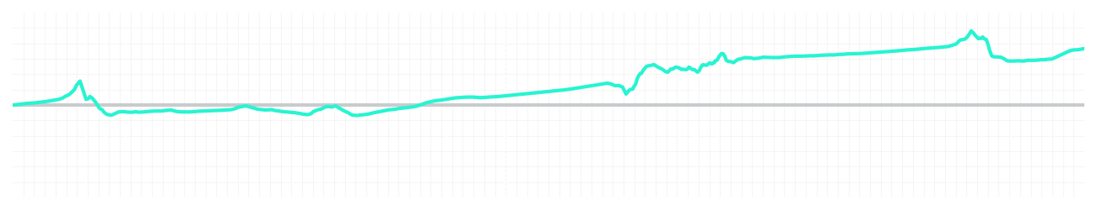
Miami GP Qualifying Q3
Kimi Antonelli
Driver
George Russell
Driver
Lap Time
01:26.271
01:26.385
Lap Time
Sector 1
28.484
Speed Trap 1
222 kp/h
Speed Trap 1
225 kp/h
Sector 1
28.622
Sector 2
32.983
Speed Trap 2
192 kp/h
Gap
-0.114
Gap
0.114
Speed Trap 2
193 kp/h
Sector 2
33.007
Sector 3
24.804
Speed Final Line
287 kp/h
Corner Advantage
20/20
Corner Advantage
0/20
Speed Final Line
286 kp/h
Sector 3
24.756
FULL THROTTLE
60%
0%
FULL THROTTLE
HEAVY BREAKING
14%
0%
HEAVY BREAKING
%LAP TIME
CORNERING
26%
100%
CORNERING
%LAP TIME
SPEED
SPEED
DELTA TIME
DELTA TIME

Slide 3

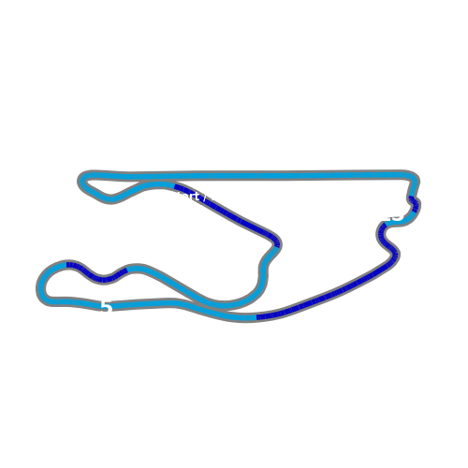


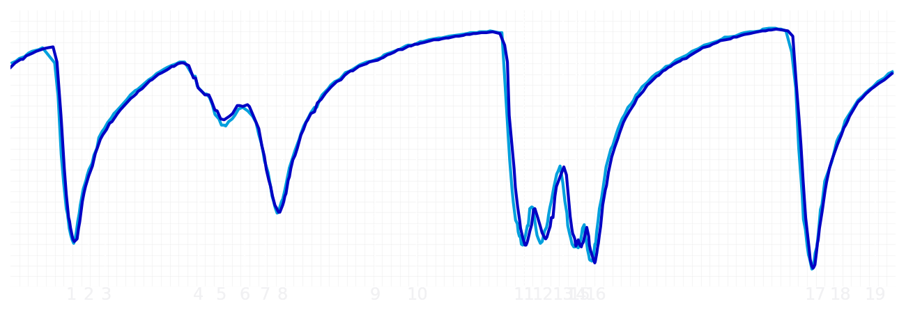
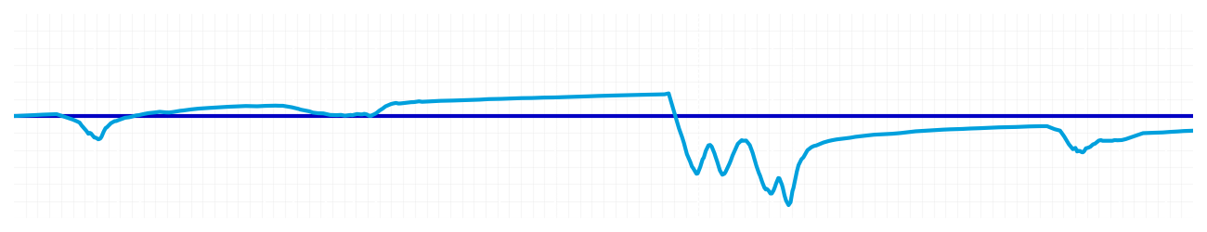
Miami GP Qualifying Q3
Alexander Albon
Driver
Carlos Sainz
Driver
Lap Time
01:26.682
01:26.569
Lap Time
Sector 1
28.633
Speed Trap 1
222 kp/h
Speed Trap 1
223 kp/h
Sector 1
28.707
Sector 2
33.261
Speed Trap 2
193 kp/h
Gap
0.113
Gap
-0.113
Speed Trap 2
192 kp/h
Sector 2
33.113
Sector 3
24.788
Speed Final Line
287 kp/h
Corner Advantage
6/20
Corner Advantage
14/20
Speed Final Line
286 kp/h
Sector 3
24.749
FULL THROTTLE
55%
41%
FULL THROTTLE
HEAVY BREAKING
21%
15%
HEAVY BREAKING
%LAP TIME
CORNERING
24%
44%
CORNERING
%LAP TIME
SPEED
SPEED
DELTA TIME
DELTA TIME

Slide 4

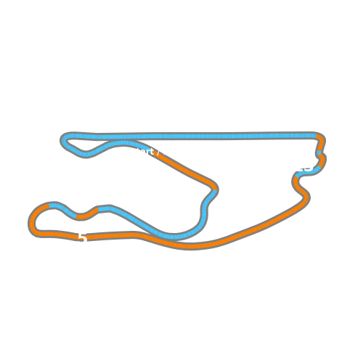


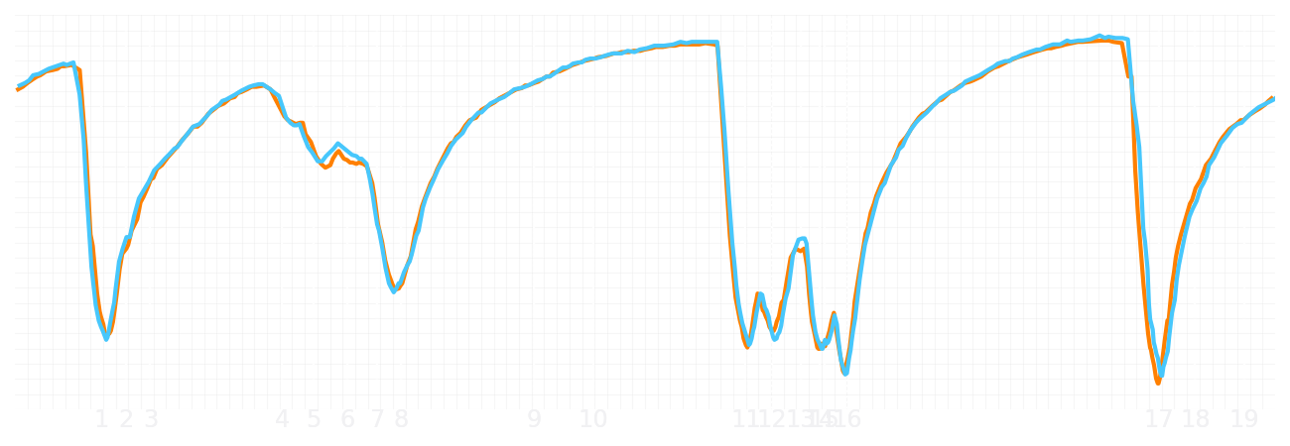
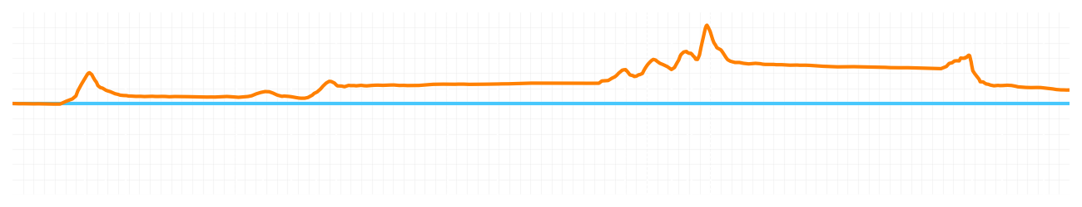
Miami GP Qualifying Q3
Lando Norris
Driver
Oscar Piastri
Driver
Lap Time
01:26.269
01:26.375
Lap Time
Sector 1
28.433
Speed Trap 1
221 kp/h
Speed Trap 1
218 kp/h
Sector 1
28.558
Sector 2
32.901
Speed Trap 2
194 kp/h
Gap
-0.106
Gap
0.106
Speed Trap 2
193 kp/h
Sector 2
33.089
Sector 3
24.935
Speed Final Line
286 kp/h
Corner Advantage
10/20
Corner Advantage
10/20
Speed Final Line
286 kp/h
Sector 3
24.728
FULL THROTTLE
58%
57%
FULL THROTTLE
HEAVY BREAKING
15%
17%
HEAVY BREAKING
%LAP TIME
CORNERING
27%
26%
CORNERING
%LAP TIME
SPEED
SPEED
DELTA TIME
DELTA TIME

